Slide 2
IBM Cloud網路存取架構 與 台灣 PoP 專線服務介紹
講義與實作文件下載處

Slide 3
Location is key Where is the traffic coming from and where is going to?
IBM Cloud
Location
PUBLIC INTERNET
Edge
Perimeter
Perimeter
PRIVATE NETWORK
Perimeter
Direct Link
Customer
Enterprise
Location
Internet
User or
Service
CIS
&
CDN
Load
Balancing
PRIVATE NETWORK
Perimeter
Internet
VPN
IBM Cloud
Location
Edge
Perimeter
Perimeter
PUBLIC INTERNET
PRIVATE NETWORK
Via
PUBLIC INTERNET
A network flow is like a line that always has a start and an end. Remember, once you go in one direction, you must return!

Slide 4

Internet Backbone
Internet only
Security: LOW!!
Cost: Low
Bandwidth: Low to High
This is the most economical method to access cloud…but has trade-offs
DDOS, Man-in-the-middle, fuzzing, etc…is all out there. Consider CIS for ingress.
Internet Secure Gateway – Cloud Foundry Public
Internet SSL VPN
Security; Moderate
Cost; Low
Bandwidth; Low [Less than 1G]
Recommended for management network access only
Most common method for mgmt control
Internet IPSec VPN [shared hardware]
Security; Moderate
Cost; Low
Bandwidth; Low
Connects back to the customer VPN router
Usually an extension of a customer’s existing mgmt network
IP address is NAT’d
Internet IPSec VPN [dedicated hardware]
Security; Moderate
Cost; Medium
Bandwidth; Low to High
Security appliance is used within the IBM cloud
Internet Only
Internet + VPN
Note; The Internet is the transport for all these solutions
Public Internet

Slide 5
Decision Tree for Selecting a Private Network Connection
Administrative
use only ?
Yes
1.Internet SSL over the internet
2.VPN over the internet (shared)
No
Allow internet attachment ?
Yes
3.VPN over the internet (dedicated)
No
Want to share NW with Multiple Clouds ?
Yes
4a.Direct Link Exchange or Connect
No
Want IBM Cloud Colocation ?
No
4b.Direct Link Dedicated
Yes
4c.Direct Link Dedicated Hosting

Slide 6
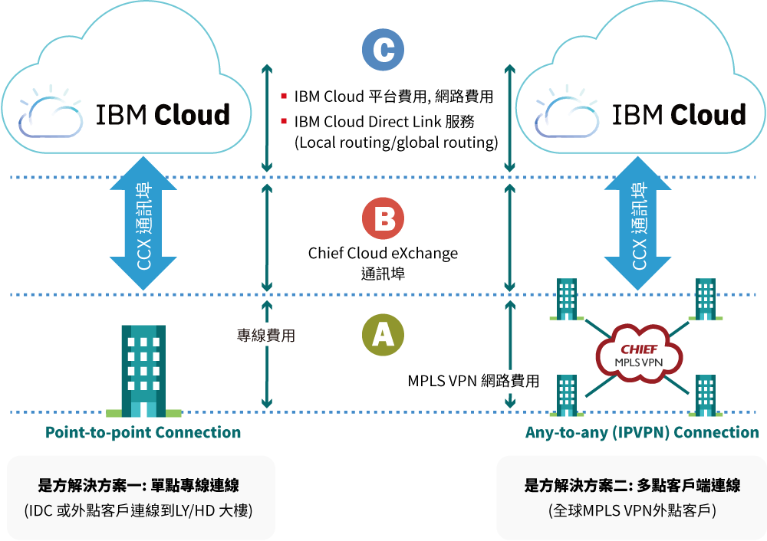
Direct Link Connect 兩種架構
(1. 專線/ 跳線 2. IP VPN)
目前接入點為香港 (預計Q2接入台灣)
https://www.chief.com.tw/dispPageBox/ct.aspx?ddsPageID=CHCLOUDSERVICE&dbid=4098738328
https://www.ibm.com/tw-zh/cloud/direct-link

Slide 7
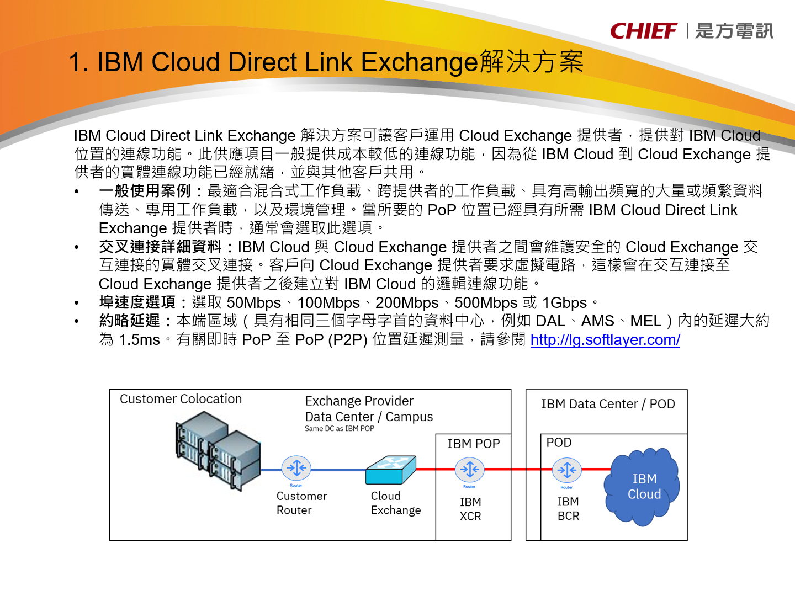
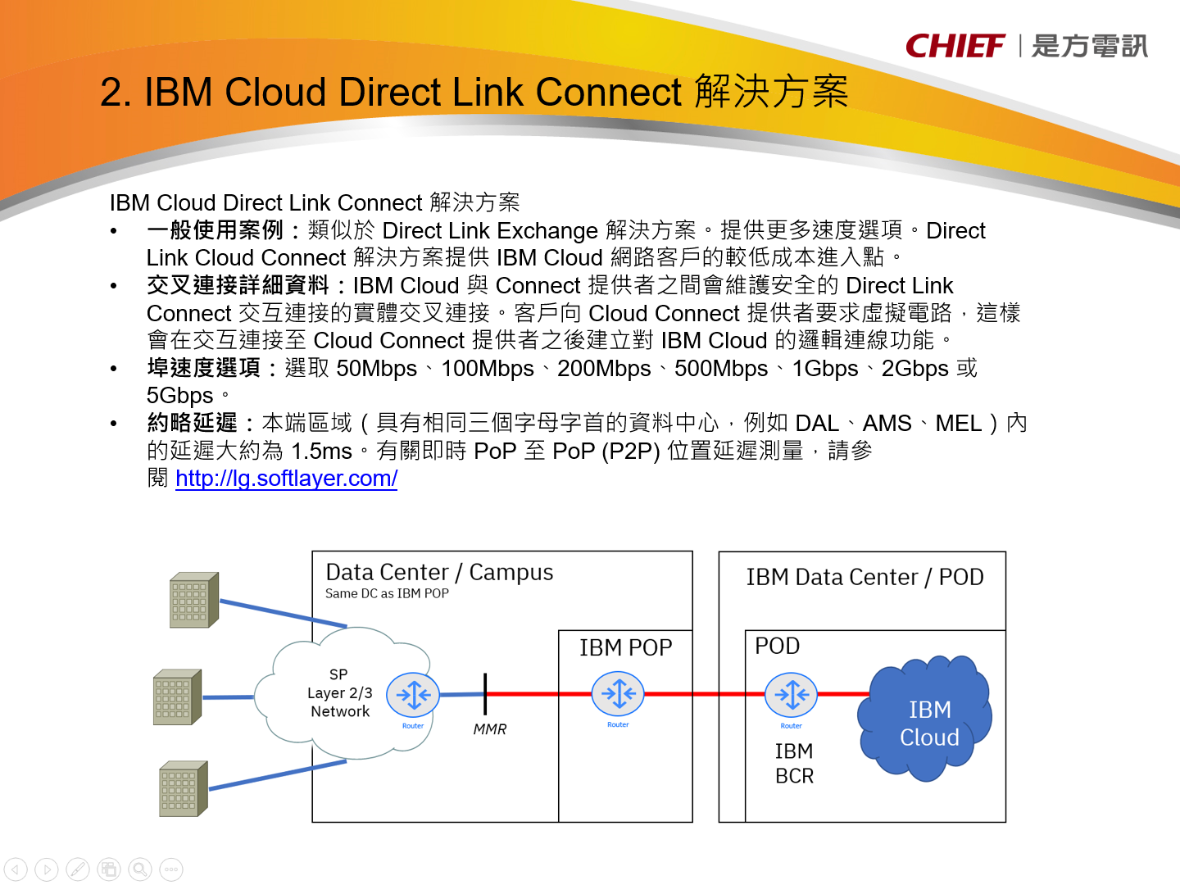
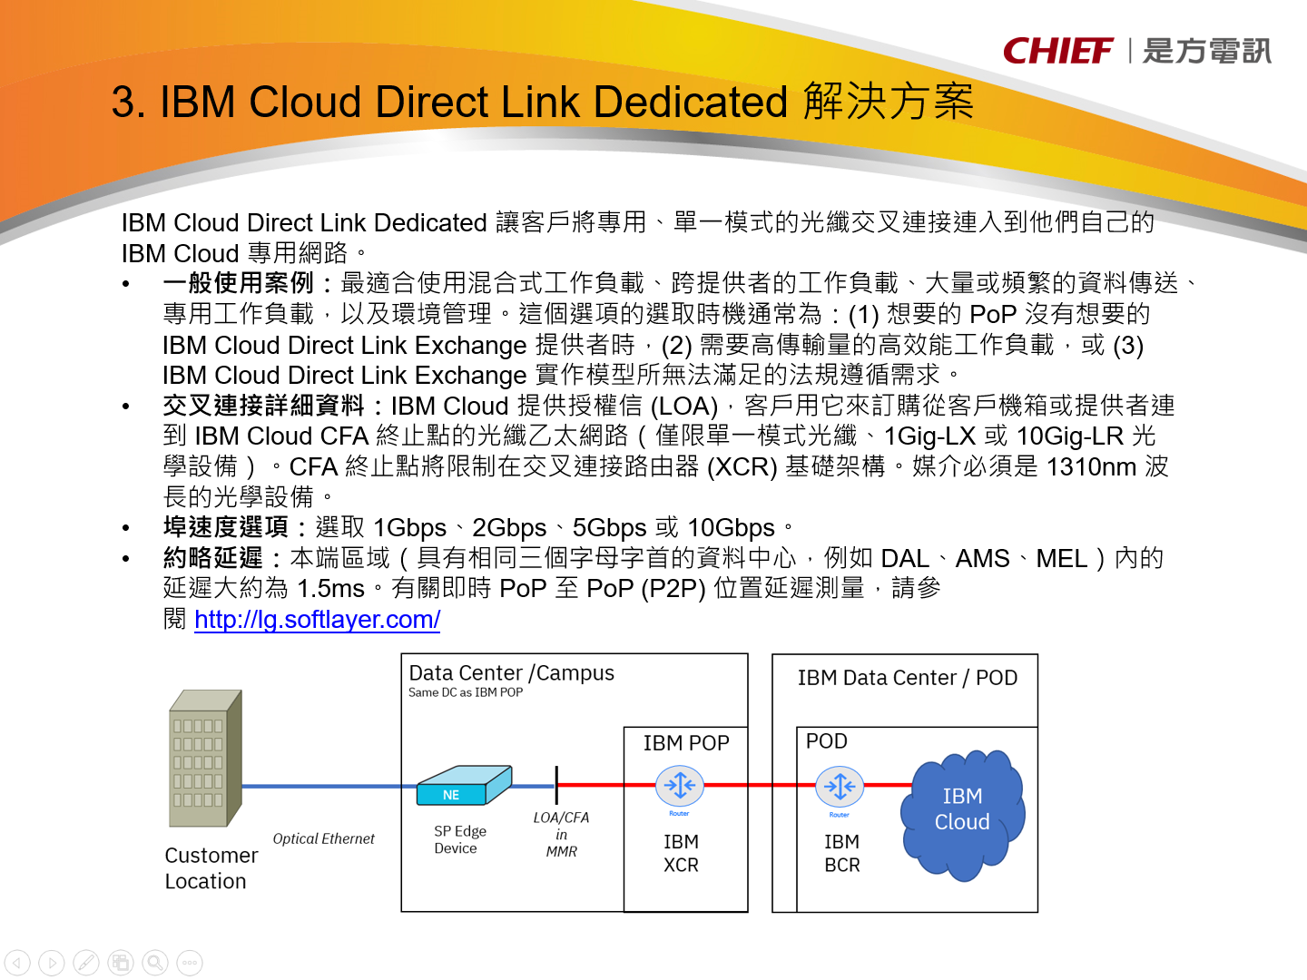
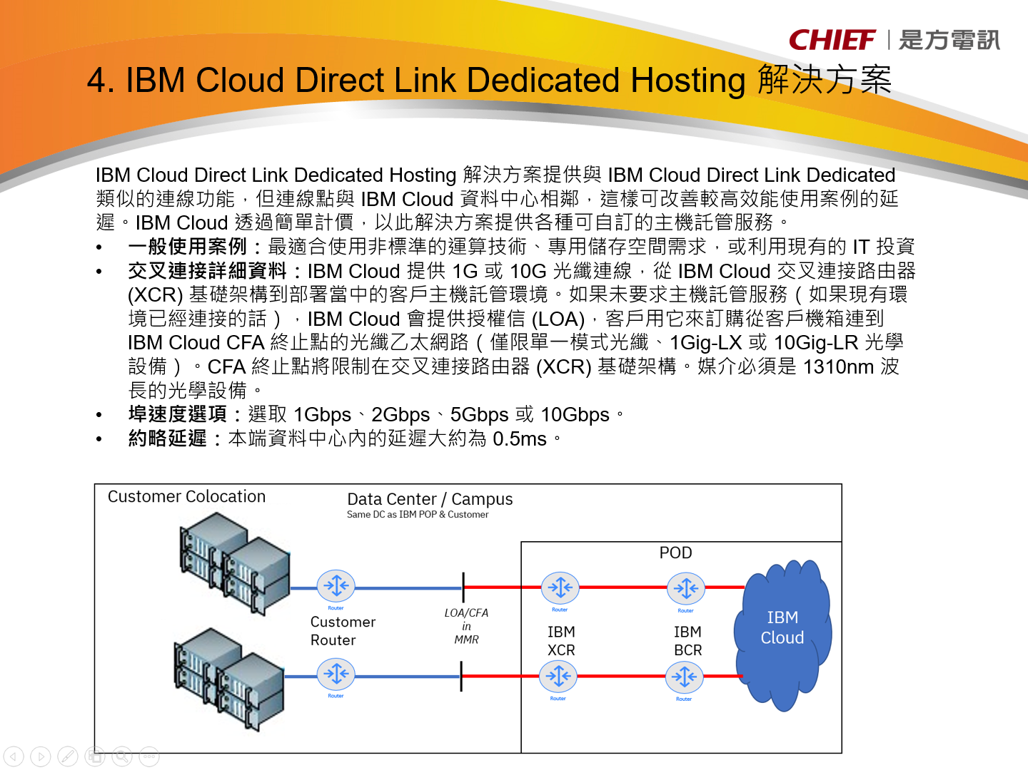

Slide 8
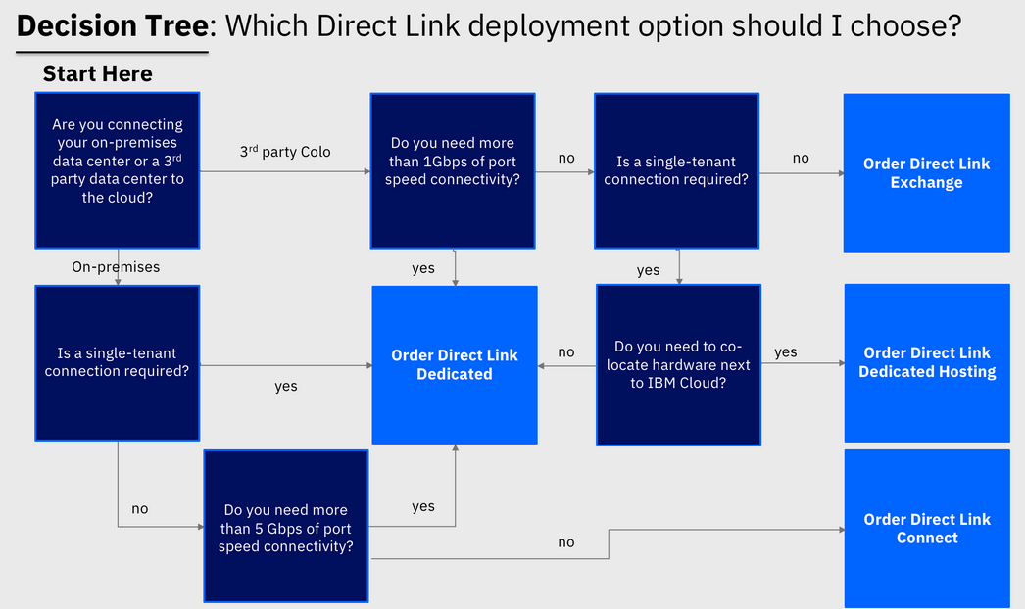

Slide 9
Jack Wu
scwu@tw.ibm.com

